Slide 1
Leveraging Meta-path based Context for Top-N Recommendation with A Neural Co-Attention Model
Advisor: JIA-LING, KOH
Source: KDD,18
SPEAKER: Rui Ze Fang
DATE: 2021/07/19

Slide 2
Outline
Introduction
Method
Experiment
Conclusion

Slide 3
Motivation
User
historical purchase records
Recommendation item
Reason for purchase :
brand , friend , category (color,…)

Slide 4
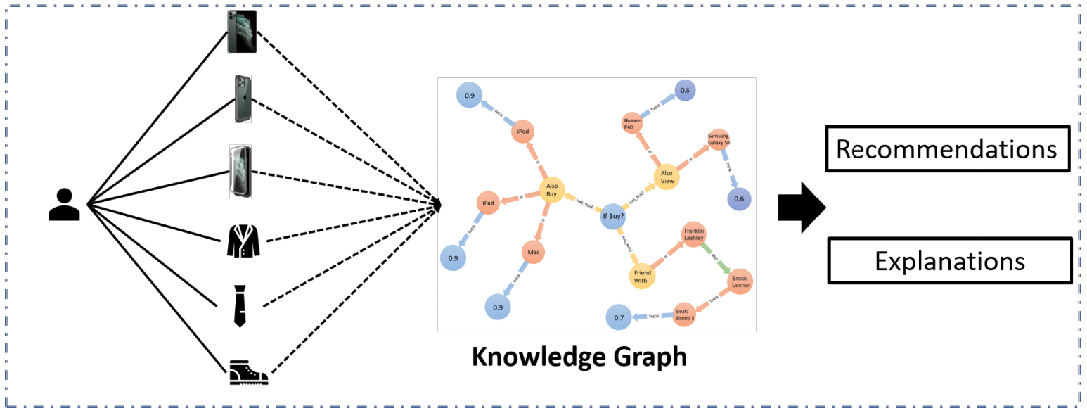
Main idea
input
+
implicit feedback matrix R∈ $R^{n∗m}$,
n: number of user ,m: number of item

Slide 5
Outline
Introduction
Method
Experiment
Conclusion

Slide 6
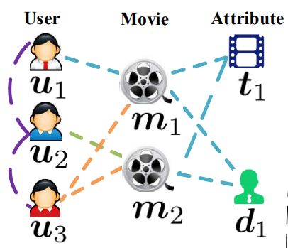
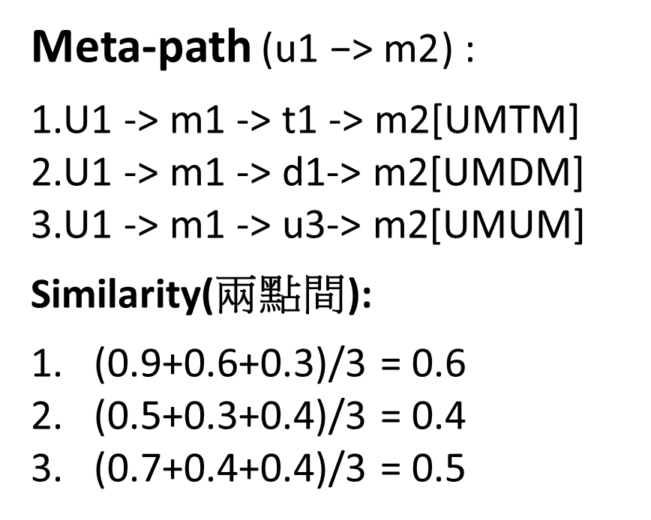
Heterogeneous Information Network
Meta-path ($\text{u}\text{1 −> }\text{m}\text{2}$) :
1.U1 -> m1 -> t1 -> m2[UMTM]
2.U1 -> m1 -> d1-> m2[UMDM]
3.U1 -> m1 -> u3-> m2[UMUM]
Similarity(兩點間):
(0.9+0.6+0.3)/3 = 0.6
(0.5+0.3+0.4)/3 = 0.4
(0.7+0.4+0.4)/3 = 0.5

Slide 7
Sampling Path Instances
Node latent vector
 | m1 | m2 | m3
U1 | 1 | 0 | 0
U2 | 0 | 1 | 0
U3 | 1 | 1 | 0
U1
U2
U3
 | m1 | m2 | m3
 | t1 | t2 | t3
m1 | 1 | 0 | 0
m2 | 1 | 0 | 1
m3 | 0 | 1 | 0
m1
m2
m3
 | t1 | t2 | t3

Slide 8
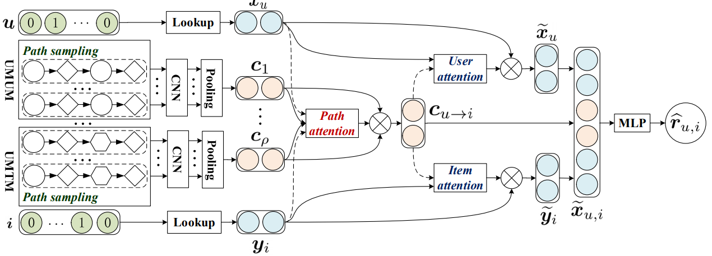
Architecture
$$x_{u}$$

Slide 9
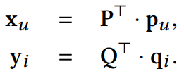
User and Item Embedding
$$x_{u}$$
$p_{u}$ ∈ $R^{|U|∗1}$, $q_{i}$ ∈ $R^{|I|∗1}$
P ∈ $R^{|U|∗d}$ , Q ∈ $R^{|I|∗d}$

Slide 10
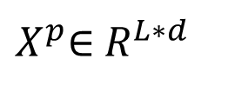
Path Instance Embedding
$X^{p}$∈ $R^{L∗d}$
$$x_{u}$$
pad
pad
1
2
3
$$h_{1}$$
Node embedding
d

Slide 11
Co-Attention Mechanism
value
query
key

Slide 12
Attention for Users and Items
value
key
query

Slide 13
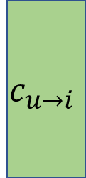
Complete Model
$${\tilde{x}}_{u}$$
$$c_{u→i}$$
$${\tilde{y}}_{i}$$
Sigmoid(ReLU(${\tilde{x}}_{u,i}$))
Loss function:

Slide 14
Outline
Introduction
Method
Experiment
Conclusion

Slide 15
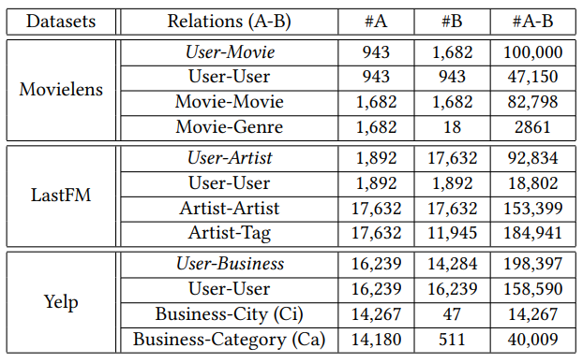
Dataset
Notes:
lastFM : music 紀錄使用者聽過那些音樂
yelp包含餐廳 美容 汽車零件 運動用品等商店之評分

Slide 16
Experiment
IF-based
HIN-based
Notes:
直接用implicit feedback以矩陣分解算user,item間的相關度當作其推薦評分(NMF:cos , MF: 矩陣分解後得到user,itrm vector再內積 BPR: )
HIN based是用meta-path算user,item間的相關度當作兩者的embedding並以兩兩內積當作其推薦評分

Slide 17
Outline
Introduction
Method
Experiment
Conclusion

Slide 18
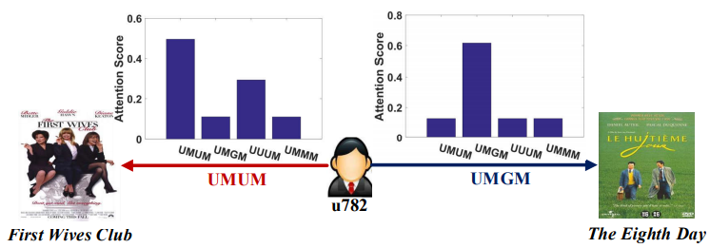
Conclusion
This model makes the recommendation results highly interpretable because of attention weight for an interaction between user u and item i
It used a priority based sampling technique to select high-quality path instances
The co-attention mechanism mutually improved the representations for meta-path based context, users and items

